Slide 1
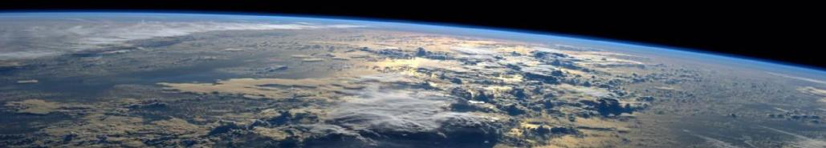

ACCP Science Impact Team – Aerosols (SIT-A)
Status
May 29, 2020
Jens Redemann, for the SIT-A team
jredemann@ou.edu

Slide 2
Outline
SIT-A – an introduction
SIT-A process/timeline for architecture assessments
Big picture approach for lidar and polarimeter retrieval assessments
Teams and methodologies involved in Quality Scoring/assessment activities
Ongoing and future work

Slide 3
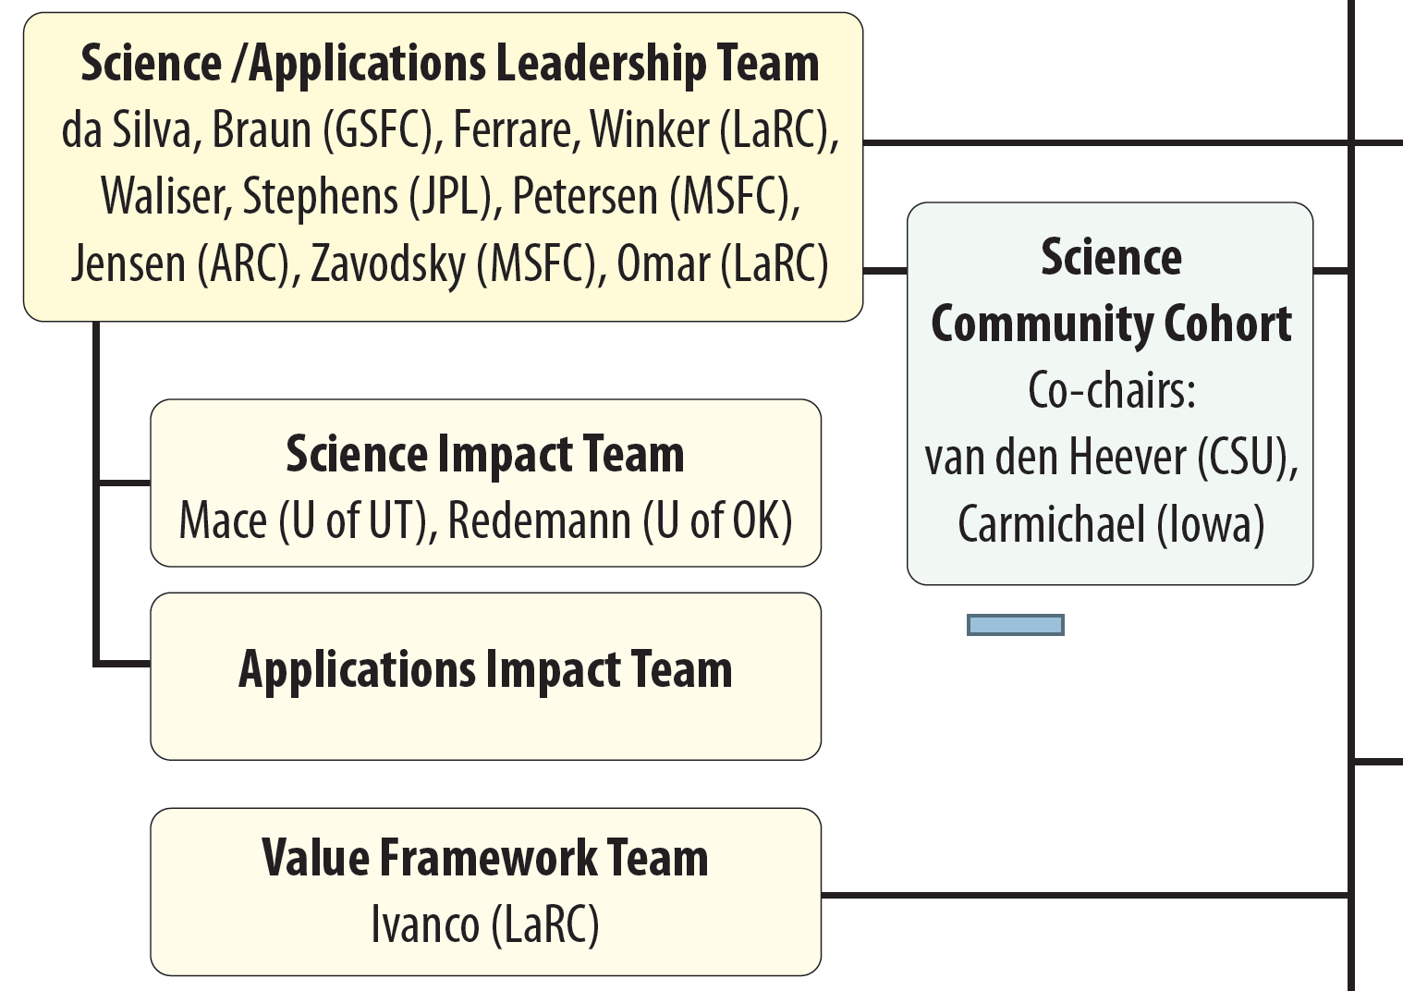
SIT-A – an introduction
Mandate: …provide quantitative information to the Value Framework Assessment (VFA) to allow assessments of the value of observing systems relative to their ability to address science objectives (with respect to A objectives).
People: Lidar and polarimeter experts from various institutions:
LaRC, GSFC, GISS, ARC, JPL, Universities

Slide 4

Scoring the Science Benefits of Architectures
Utility: degree to which Geophysical Variable (GV) addresses the objective if it were measured perfectly.
= $\frac{1}{N}$ $\sum{} ×$
Utility of GV for Objective
Quality of GV given Measurements
Science Benefit Score
GVs
(SALT)
(SIT)
(for Objective)
Quality: degree to which measurements provide the desired geophysical variable. OSSEs inform the quality assessment.
Similar to approach outlined on Continuity of NASA Earth
Observations from Space report (NAS 2015)
4

Slide 5
The expert team, aka study team
Process & Timeline
Considerations for weighting and nudging

Slide 6
The study team was assembled with the following ideas in mind:
Balance between lidar and polarimeter people, with an emphasis on joint retrievals and slight preponderance of polarimeter experts, as only one GV is fully vertically resolved
Balance between retrievals experts at various centers and institutions
The team includes:
GISS: Brian Cairns
GSFC: Reed Espinosa, Ed Nowottnick, John Yorks
UWisc: Bob Holz
OU: Feng Xu, Jens Redemann
LaRC: Sharon Burton, Snorre Stamnes, Tyler Thorsen, Mark Vaughan
ULille: Oleg Dubovik

Slide 7
Process:
The study team assessment of individual quality scoring efforts will entail two steps:
STEP 1: Weighting of Quality Scores
STEP 2: Recommendations for “adjusting” the weighted scores

Slide 8
SIT-A Process/Timeline for Architecture Assessments
Assessment of existing and development of new algorithmic capabilities (Feb 2019 – present)
Discussions on procedures for evaluating architecture and instrument capabilities
Development/Refinement of various methodologies, streamlining in as far as appropriate
Comparisons of simulated lidar and polarimeter signals (forward models)
Preliminary Assessment of Architecture 8G for presentation to SCC (Dec 2019)
Formal Assessment (incl. study team review) of Architecture 8G for SMT (Feb 2020)
Preparations for Assessment of Architecture 8K + derivatives (Feb – May 2020)
Various improvements over 8G assessment targeted:
Use realistic lidar uncertainty estimates for specific lidars (5, 6, 9)
Extend list of Geophysical Variables to include “Enhanced” and more vertically-resolved GVs
Add polarizing land surfaces
Add low AOD cases to canonical case tables
Consider realistic distribution of viewing geometries
Add objective-specific canonical test cases
Formal Assessment of Architecture 8K + derivatives for SMT (June 2020)
Formal Assessment of Architecture 11 for SMT (August 2020)

Slide 9
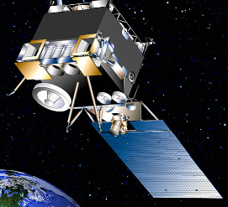
Architectures Under Detailed Study— Preliminary Costs Still In Work
SATM Goals/Objectives | Unique Science Implementation Strategies | Mission Implementation Strategies (CDCs)
SATM Rel F 5 Goals 8 Objectives | Seasonal Vertically Resolved Cloud & Aerosol Process & AT VARIOUS TIMES OF DAY | 8G, 8G-1 1 Lg 1 Med SC 8K, 8K-1, 8K-2 1 Med SC 1 ESPA Grande SC 2 ESPA SmallSats
 | Seasonal Vertically Resolved Cloud & Aerosol Process OVER SEVERAL MINUTE TIME SCALES TO GET TIME EVOLUTION | 11A 1 Med SC (Descoped) 1 ESPA Grande SC 4 ESPA SmallSats
 | Seasonal Vertically Resolved Cloud & Aerosol Process OVER SEVERAL MINUTE TIME SCALES & AT VARIOUS TIMES OF DAY (Compromises Vertical Measurements for Sampling) | 11B 1 Med SC 5 ESPA SmallSats 11C 2 ESPA Grande 5 ESPA SmallSats
8G SSP: $1109
8G-1 SSP: $1165
Note: These costs
could be high
SSP-1: $702
SSP-2: $316
Arch 8K: $1603
Arch 8K-1
Arch 8K-2
SSG-1: $298
SSP-2: $287
Arch 8G: $1880K
Arch 8G-1: $1950K
8G SSG: $771
8G-1 SSG: $785
SSP1: $665
SSP2: $784
dt2: $99
dt1: $70
dt4: $99
dt3: $32
Working with Commercial Bus Providers
on Spacecraft/Launch Options
for Multiple Spacecraft in Same Orbit Plane To
Reduce Cost & Simplify Communications
Arch 11A: $1748
Orbits considered so far are polar sun-synchronous 450km, 1:30p.m. Ascending Node Crossing and 407km, 65deg/35deg Incl
SSP1: $973
dt5: $80
SSP1: $747
SSP2: $120
SSP3: $32
dt1: $139
dt2: $139
dt3: $72
dt4: $72
SSG1: $641
dt1: $70
dt2: $99
dt3: $32
Arch 11B: $1475
Arch 11C: $1741
9
9

Slide 10
Architecture 8G Mission Implementation Details & Potential De-Scopes
Arch 8G
Arch 8G-1
1st Launch—SSG (2029)
1 International Contribution—Radio9b
Potential De-Scopes:
Radar 12 in lieu of Radar 13
2nd Launch—SSP (2031)
1 International Contribution—Spec03
Potential Add: Spec for Radiation
SSP: Radar13,
Radio07, Spec03,
Lidar05, Polar07
8G SSG: Radar13, Radio9b/10,
Lidar09, Polar07
8G-1 SSG: Radar12, Radar17,
Radio9b/10, Lidar09, Polar07

Slide 11
Architecture 8K/8K-1/8K-2 Science Emphasizes Vertical & Diurnal / No Delta t
1st Launch—SSG1 & SSG2 (2029)
Some Aerosol (BS/Polarimeter) & W No Doppler/Ka Doppler CCP Capability
2nd Launch—SSP (2031)
Full Aerosol (HSRL/Polarimeter) & W & Ka Doppler CCP Capability
Emphasizes Vertical with Lidar & Doppler in Both Planes
Emphasizes ACCP in both launches
Gets Time of Day data but no Delta t
8K-1 adds UV HSRL Lidar
8K-2 removes HSRL
Arch 8K
Arch 8K-1
Arch 8K-2
8K SSP1: Spec03,
Lidar05, Polar07
8K-1 SSP1: Spec03,
Lidar06, Polar07
8K-2 SSP1: Spec03,
Lidar09, Polar07
SSP2: Radar13,
Radio07
ACCP Tenet | 8K SSP | 8K-1 SSP | 8K-2 SSP | 8K SSG
Addresses A and CCP | √ | √ | √ | √
Diurnal Cycle | No | No | No | √
Polar Regions | √ | √ | √ | No
Continuity | Lidar, W | Lidar, W | Lidar, W | Ka?
Vertical Velocity | Dop. W, Ka | Dop. W, Ka | Dop. W, Ka | Dop. Ka
ΔT | No | No | No | No
Direct extinction | √ | √ | No | No
Radar & lidar | √ | √ | √ | √
SSG1: Lidar09, Polar04b
SSG2: Radar12, Radio7
KaD, WD Radar
118/183/240/310/380/660/880 Radiometer
LWIR/FIR Spectrometer
60/10 Angle Polarimeter
8K: 532/1064nm Lidar (532 HSRL)
8K-1: 355/532/1064nm Lidar (355, 532 HSRL)
8K-2: 532/1064nm Lidar (No HSRL)
KaD, W Radar
118/183/240/310/380/660/
880 Radiometer
60/10 Angle Polarimeter
532/1064nm Lidar (No HSRL)

Slide 12
SIT-A: People and Tasking
For each instrument type or combination, a variety of groups pursue independent lines of inquiry into instrument/architecture capabilities
Differences in methodologies & algorithms is an advantage to the evaluation process
Retrievals
Retrievals
Retrievals
Related work
Full SIT-A
Interpretation of instrument info
Nature runs & Sampling Studies
Definition of Canonical Cases
Review of retrieval work
…
Lidars
Backscatter: Yorks, Nowottnick, Powell, Vaughan, Winker
HSRL: Burton, Ferrare, Winker, Hair
Polarimeters
LaRC: Stamnes, Burton
OU: Xu, Gao, Redemann
LaRC: Stamnes, Burton, Powell
Combinations
GSFC: Espinosa, da Silva
GISS: Cairns
OU: Xu, Gao, Redemann
GISS: Cairns
GSFC: Yorks, Nowottnick, Espinosa, da Silva

Slide 13
Four methodologies to evaluate architecture performance
Information content analysis (ICA) – LaRC+GISS/OU
Uses “a retrieval-free methodology to determine the basic sensitivities of the measurements independent of retrieval assumptions and constraints” (from Burton et al., 2016)
Strength: tests impact of a priori constraints; efficient calculation for large set of aerosol scenarios; focus on propagation of measurement errors (not retrieval errors); simplifies assessment of relative strengths
Limitation: assumes successful retrieval convergence to the true solution; linear assumption of forward model response to the perturbations of retrieval parameters in Jacobian evaluation
“Statistical” Direct Retrieval Simulation (DRS) – LaRC+GISS/GSFC/OU
Uses canonical cases or nature run output and optimal estimation to retrieve GVs from simulated, noise-added signals
Strength: Tests the effect of a priori constraints and measurement biases, reflects the impact of initial guess and numerical instability/ill-posedness.
Limitation: Computationally expensive for a comprehensive study
Statistical DRS performance analysis (SPA) – LaRC/GSFC
Uses forward model and optimal estimation to retrieve GVs from simulated (incl. varied microphysics), noise-added signals
Strength: Provides performance using a large number of cases for a range of parameters
Limitation: Computationally expensive; simplifications
Real data analysis (RDA) – LaRC+GISS/GSFC/OU (planned)
Uses actual data collected by lidars and polarimeters to test retrievals (may include comparison to in situ data)
Strength: fidelity to measurement reality
Limitation: constrained by existing instrumental setting in terms of spectral channels, view angles, resolution and swath; needs ground truth; retrieval methodology error coupled with modeling error and measurement errors

Slide 14
Evolution of SIT-A assessments
Assessment → Feature ↓ | 8G assessment | 8K assessment(s) | Future change
Instruments | SSP: Lidar 5 + Pol 7 SSG: Lidar 9 + Pol 4b | SSP: Lidar 5/6/9 + Pol 7 (8K, 8K-1, 8K-2) SSG: Lidar 9 + Pol 4b
Observing modes | 1 – Nadir, daytime Nd | Nadir, daytime (nd) 2. Nadir, nighttime (nn) 3. Off nadir, daytime (od) 4. Off nadir, nighttime (on, CCP only) | NA
Lidar uncertainties | Generic: 5% in total/attenuated backsc. 17 Mm⁻¹ in extinction | Realistic, instrument-specific for all three lidars considered (i.e., 05, 06, 09) | NA
GEOS-5 Nature Runs | Not used | Sampling of pdf of viewing geometries | Sampling of joint pdf’s of viewing geometries, aerosol prop., surfaces
Geophysical Variables | GV1 (SSA), column & PBL GV2 (ASYM), column GV3 (AE2BR), column & PBL GV4 (AODF), column & PBL GV6 (AOD), column & PBL GV7 (ARIR), column & PBL GV8 (AEXT), profile | 8G, plus: AABS, profile; AAOD, column & PBL; AEFR, profile; AEFR, column & PBL; AEXTF, profile; ANC, profile; APM25, surface (includes Enhanced GVs and their uncertainties)
Surfaces | Ocean only | Ocean Two polarizing land surfaces (vegetated, desert)
Canonical Case Table | 6 cases, all AOD 0.35, two slab layers (smoke, spherical dust, pollution, marine) | 9 cases, incl. 3 objective specific cases (pristine marine w/ low AOD=0.05; polluted marine w/ low AOD=0.1; smoke above high conc. pollution w AOD=0.6) | Non-spherical dust Below-Ci Above low Sc

Slide 15
Details for expanded 8K assessments
A list of improvements to pursue between 8G and 8K assessments:
Add lidar uncertainties in all retrieval simulations
Add land pol BPDF
Add AOD=0.1 cases
Study the lidar options as part of 8K derivatives (8K-1 and 8K-2)
Include more and enhanced GV’s, and following resolutions (hor./vert.):
Priority 1: 50km/500m, joint retrievals
Priority 2: 5km/500m, joint retrievals, 5km/30m, if possible (extinction only reported)
Priority 3: 25km/500m, joint retrievals
Priority 4: 1km/30m (extinction only reported)
Run lidar-only, polarimeter-only and combined retrievals
Add output from GEOS NR:
Viewing geometries
Aerosol property pdf’s
Attribute input instrument uncertainties to random and systematic components
Add objective-specific canonical cases, e.g.,:
Objective 8 (aerosol indirect) - low AOT cases (<0.1) to study cloud susceptibility to aerosols in low aerosol conditions during daytime
Objective 7 (direct effects) – include cases of aerosols under thin clouds and above bright clouds; tenuous aerosols often missed by previous satellite measurements, maybe lidar-only?
Objective 5 (air quality) – high AOT cases (>0.5) during daytime and nighttime associated with high surface PM_{2.5}
Add non-spherical particles (incl. larger large-mode sea-salt)
Add retrieval cases below thin Ci
Platform | 8K | 8K-1 | 8K-2
SSG-1 | Pol4b, Lidar9
SSP-1 | Pol7, Lidar5 | Pol7, Lidar6 | Pol7, Lidar9

Slide 16
Most relevant canonical cases (V27) in a nutshell
All @550nm
Aerosol Type (loading) | Case # | AOD_{f} | AOD_{c} | AOD_{total} | SSA_{f} | SSA_{c} | SSA_{total} | Surfaces
Smoke (high) over marine (low) | 6a | 0.217 | 0.033 | 0.250 | 0.834 | 0.999 | 0.856 | All
 |  | 0.029 | 0.071 | 0.100 | 0.987 | 1.000 | 0.996
Smoke (low) over marine (high) | 6b | 0.087 | 0.013 | 0.100 | 0.834 | 0.999 | 0.856 | Ocean
 |  | 0.072 | 0.178 | 0.250 | 0.987 | 1.000 | 0.996
Smoke (high) over pollution (low) | 6c | 0.217 | 0.033 | 0.250 | 0.834 | 0.999 | 0.856 | All
 |  | 0.092 | 0.008 | 0.100 | 0.993 | 0.829 | 0.980
Smoke (low) over pollution (high) | 6d | 0.087 | 0.013 | 0.100 | 0.834 | 0.999 | 0.856 | All
 |  | 0.229 | 0.021 | 0.250 | 0.993 | 0.829 | 0.980
Spherical dust (high) over marine (low) | 6e | 0.133 | 0.117 | 0.250 | 1.000 | 0.872 | 0.940 | All
 |  | 0.029 | 0.071 | 0.100 | 0.987 | 1.000 | 0.996
Spherical dust (low) over marine (high) | 6f | 0.053 | 0.047 | 0.100 | 1.000 | 0.872 | 0.940 | Ocean
 |  | 0.072 | 0.178 | 0.250 | 0.987 | 1.000 | 0.996
Marine | 6g | 0.014 | 0.036 | 0.050 | 0.987 | 1.000 | 0.996 | Ocean
Polluted marine | 6h | 0.072 | 0.028 | 0.100 | 0.993 | 1.000 | 0.995 | All
Smoke (low) over pollution (high) | 6i | 0.087 | 0.013 | 0.100 | 0.834 | 0.999 | 0.856 | All
 |  | 0.459 | 0.041 | 0.500 | 0.993 | 0.829 | 0.980

Slide 17
Two-step approach for 8K assessments
QI scoring:
Extended list of GVs assessed (see slide 16, 17, and 21)
Evaluate quality scores for 8K-SSP: Lidar 5/6/9 + Pol 7 (8K-0, 8K-1, 8K-2) & 8K-SSG: Lidar 9 + Pol 4b separately
Observing Modes (Nadir day-time Nd, Nadir night-time Nn, Off-Nadir day-time Od, Off-Nadir night-time On)
Consider (number?) separate methodologies for assessing QI scores and uncertainties, which were solicited and submitted openly, i.e., for entire SIT-A to review
Define QI scores as the fraction of “successful retrievals” for a given GV, i.e., the fraction of retrievals that yield uncertainties within the SATM stated desired capabilities
Study team reviews:
Select new, extended study team
Groups present results to study team for each methodology
Study team member assign weights to each methodology and GV in each of the three categories Validity/adequacy, Technical readiness, and Representativeness anonymously

Slide 18
8K Study team reviews:
Select new, extended study team
Groups present results to study team for each methodology
Study team members anonymously assign weights to each methodology and GV in each of the three categories Validity/adequacy, Technical readiness, and Representativeness
Study team discusses what QI scores and uncertainties would have looked like in a more complex retrieval environment
Study team deliberates on probable lower bounds of the success rates of future retrieval and expresses them in terms of percentage decreases of successful retrievals
These lower bounds are derived on the basis of the mean QI scores and mean uncertainties, and represent the study team’s best estimate how the QI scores may decrease in the future, with more complex retrieval sim’s

Slide 19
GVs for 8K assessments
GV# | Case -> GV | GV description | GV uncertainty in SATM | Scales |  | Comment
 |  |  |  | XY (km) | Z (m)
1 | AABS.z, profile | Aerosol Absorption (Profile) | SSA: ±0.03 | 50 | 500
2 | AAOD.l, column | Aerosol Absorption Optical Depth (Column and PBL) | SSA: ±0.04 | (1,50) | --- | UV-VIS for column, VIS for PBL
 | AAOD.l, PBL |  | SSA: ±0.02
 |  |  | SSA: ±0.02 | (1,25) | ---
3 | ASYM | Aerosol Asymmetry Parameter | ±0.02 | 1 ? | --- | UV-VIS
4 | ACFM.z | §Aerosol-Cloud Feature Mask (Profile) | 1%, for OD > 0.1
5 | AEFR.z, profile | Aerosol Effective Radius (Profile) | ±20% for extinction > 0.05 km⁻¹ | 50 | 500
6 | AEFR.l, column | Aerosol Effective Radius (Column and PBL) | 0.1 um or 10% | (1,50) | ---
 | AEFR.l, PBL |  |  | (1,25) | ---
7 | AEXT.z, profile | Aerosol Extinction Profile | Max of (0.02 km-1, ±20%) | 5 | 30
 |  |  |  | 1
8 | AE2BR.z, profile | Aerosol Extinction to Backscatter Ratio (Profile) | ±25% | 50 | 500
9 | AE2BR.l, column | Aerosol Extinction to Backscatter Ratio (Column,PBL) | ±25% | (1,50) | ---
 | AE2BR.l, PBL |  |  | (1,25) | ---
 | AE2BR.l, PBL
10 | AEXTF.z, profile | Aerosol Fine Mode Extinction Profile | Max of (0.02 km-1, ±20%) | 50 | 500
11 | AODF.l, column | Aerosol Fine Mode Optical Depth (Column and PBL) | ±0.02±0.05*AOT | (1,50) | ---
 | AODF.l, PBL
 | AODF.l, PBL |  |  | (1,25) | ---
12 | ANSPH.l, column | Aerosol Non-spherical AOD Fraction (Column,PBL) | ±10% | (1,50) | ---
 | ANSPH.l, PBL |  |  | (1,25) | ---
13 | ANSPH.z, profile | Aerosol Non-spherical Extinction Fraction Profile | ±10% | 50 | 500
14 | ANC.z, profile | Aerosol Number Concentration Profile | 50% | 50 | 500
15 | AOD.l, column | Aerosol Optical Depth (Column,PBL) | ±0.02±0.05*AOT | (1,5) | --- | Swath: 100 km (minimum) , 300 km (enhanced)
 | AOD.l, PBL
16 | APM25 | Aerosol PM2.5 Concentration (surface) | +/-20-25% | 5 | ---
17 | ARIR.l, column | Aerosol Real Index of Refraction (Column,PBL) | ±0.025 | (1,50) | ---
 |  |  |  | (1,25) | ---
 | ARIR.l, PBL
18 | AIIR.l, column | Aerosol Imaginary Index of Refraction (Column,PBL) | ±0.025 | (1,50) | ---
 | AIIR.l, PBL |  |  | (1,25) | ---

Slide 20
GVs for 8K assessments
GV# | Case -> GV | GV description | GV uncertainty in SATM | Scales |  | Objective
 |  |  |  | XY (km) | Z (m) | O5 | O6 | O7 | O8
1 | AABS.z, profile | Aerosol Absorption (Profile) | SSA: ±0.03 | 50 | 500 | Yes | Yes | Yes
2 | AAOD.l, column | Aerosol Absorption Optical Depth (Column and PBL) | SSA: ±0.04 | (1,50) | --- | Yes | Yes | Yes
 | AAOD.l, PBL |  | SSA: ±0.02
 |  |  | SSA: ±0.02 | (1,25) | --- | Yes | Yes | Yes
3 | ASYM | Aerosol Asymmetry Parameter | ±0.02 | 1 ? | --- |  |  | Yes
4 | ACFM.z | §Aerosol-Cloud Feature Mask (Profile) | 1%, for OD > 0.1
5 | AEFR.z, profile | Aerosol Effective Radius (Profile) | ±20% for extinction > 0.05 km⁻¹ | 50 | 500 | Yes | Yes | ? | Yes
6 | AEFR.l, column | Aerosol Effective Radius (Column and PBL) | 0.1 um or 10% | (1,50) | --- | Yes | ? | Yes | ?
 | AEFR.l, PBL |  |  | (1,25) | --- | Yes | ? | Yes | ?
7 | AEXT.z, profile | Aerosol Extinction Profile | Max of (0.02 km-1, ±20%) | 5 | 30 | Yes | Yes | Yes | Yes
 |  |  |  | 1 | 30 | Yes | Yes | Yes | Yes
8 | AE2BR.z, profile | Aerosol Extinction to Backscatter Ratio (Profile) | ±25% | 50 | 500 | Yes | ? | ?
9 | AE2BR.l, column | Aerosol Extinction to Backscatter Ratio (Column,PBL) | ±25% | (1,50) | --- | Yes | Yes | Yes
 | AE2BR.l, PBL |  |  | (1,25) | --- | Yes | Yes | Yes
 | AE2BR.l, PBL
10 | AEXTF.z, profile | Aerosol Fine Mode Extinction Profile | Max of (0.02 km-1, ±20%) | 50 | 500 | Yes | Yes | Yes | ?
11 | AODF.l, column | Aerosol Fine Mode Optical Depth (Column and PBL) | ±0.02±0.05*AOT | (1,50) | --- | Yes | Yes | Yes | Yes
 | AODF.l, PBL
 | AODF.l, PBL |  |  | (1,25) | --- | Yes | Yes | Yes | Yes
12 | ANSPH.l, column | Aerosol Non-spherical AOD Fraction (Column,PBL) | ±10% | (1,50) | ---
 | ANSPH.l, PBL |  |  | (1,25) | ---
13 | ANSPH.z, profile | Aerosol Non-spherical Extinction Fraction Profile | ±10% | 50 | 500 | Yes | Yes | Yes | Yes
14 | ANC.z, profile | Aerosol Number Concentration Profile | 50% | 50 | 500 |  |  |  | Yes
15 | AOD.l, column | Aerosol Optical Depth (Column,PBL) | ±0.02±0.05*AOT | (1,5) | --- | Yes | Yes | Yes | Yes
 | AOD.l, PBL |  |  |  |  | Yes | Yes | Yes | Yes
16 | APM25 | Aerosol PM2.5 Concentration (surface) | +/-20-25% | 5 | --- | Yes
17 | ARIR.l, column | Aerosol Real Index of Refraction (Column,PBL) | ±0.025 | (1,50) | --- | Yes | Yes | Yes
 |  |  |  | (1,25) | --- | Yes | Yes | Yes
 | ARIR.l, PBL
18 | AIIR.l, column | Aerosol Imaginary Index of Refraction (Column,PBL) | ±0.025 | (1,50) | --- | Yes | Yes | Yes
 | AIIR.l, PBL |  |  | (1,25) | --- | Yes | Yes | Yes

Slide 21
Interface with the Value Framework Team
 | Polar7 == Polar4b in terms of channels, uncertainties |  |  |  |  |  |  |  |  | high | medium | low
 |  |  |  |  |  |  |  |  |  | Key for probability of delivering
 | Observing Mode -> | Nadir day-time Nd |  |  |  |  |  |  |  | Nadir night-time Nn |  |  | Off-nadir day-time Od
 | Instruments -> | Lidar-only |  |  |  | Combined Lidar + Polarimeter |  |  |  | Lidar-only |  |  | Polarimeter-only (swath)
Group - Lead | Methodology | Lidar05 | Lidar06 | Lidar06 | Lidar09 | Polar7 + Lidar05 (SSO) | Polar7 + Lidar06 (SSO) | Polar7 + Lidar09 (SSO) | Polar4b + Lidar09 (GPM) | Lidar05 | Lidar06 | LIdar09 | Polar7 (SSO) | Polar4b (GPM)
LaRC - Powell | DRS | yes | yes | yes | yes |  |  |  |  | yes | yes | yes
LaRC/GISS - Burton | ICA | cases 6a,b,c,d,g,h,i | cases 6a,b,c,d,g,h,i | cases 6a,b,c,d,g,h,i | cases 6a,b,c,d,g,h,i | cases 6a,b,c,d,g,h,i | cases 6a,b,c,d,g,h,i | cases 6a,b,c,d,g,h,i | maybe | cases 6a,b,c,d,g,h,i | cases 6a,b,c,d,g,h,i | cases 6a,b,c,d,g,h,i | cases 6a,b,c,d,g,h,i | maybe
LaRC/GISS - Stamnes | DRS |  |  |  |  | yes | yes | yes | low
LaRC/GISS - Stamnes | SPA |  |  |  |  |  |  |  |  |  |  |  | yes | yes
GSFC - Espinosa | DRS | cases 6a-k | cases 6a-k | cases 6a-k | cases 6a-k | cases 6a-k | cases 6a-k | cases 6a-k | cases 6a-k | cases 6a-k | cases 6a-k | cases 6a-k | cases 6a-k | cases 6a-k
GSFC - Espinosa | ICA
GSFC - Espinosa | SPA | yes | yes | yes | yes | yes | yes | yes | yes | yes | yes | yes | yes | yes
GSFC - Espinosa | RDA
OU - Xu | DRS | yes | yes | yes | yes | yes | yes | yes | yes | low | low | low | yes | yes
OU - Xu | ICA | yes | yes | yes | yes | yes | yes | yes | yes | low | low | low | yes | yes
OU - Xu | SPA
OU - Xu | RDA | low | low | low | low | low | low | low | low | low | low | low | low | low
CNES | DRS
CNES | ICA
CNES | SPA
CNES | RDA

Slide 22
Interface with the Value Framework Team
 | Polar7 == Polar4b in terms of channels, uncertainties |  |  |  |  |  |  |  |  | high | medium | low
 |  |  |  |  |  |  |  |  |  | Key for probability of delivering
 | Observing Mode -> | Nadir day-time Nd |  |  |  |  |  |  |  | Nadir night-time Nn |  |  | Off-nadir day-time Od
 | Instruments -> | Lidar-only |  |  |  | Combined Lidar + Polarimeter |  |  |  | Lidar-only |  |  | Polarimeter-only (swath)
Group - Lead | Methodology | Lidar05 | Lidar06 | Lidar06 | Lidar09 | Polar7 + Lidar05 (SSO) | Polar7 + Lidar06 (SSO) | Polar7 + Lidar09 (SSO) | Polar4b + Lidar09 (GPM) | Lidar05 | Lidar06 | LIdar09 | Polar7 (SSO) | Polar4b (GPM)
LaRC - Powell | DRS x 1 | yes | yes | yes | yes |  |  |  |  | yes | yes | yes
LaRC/GISS - Burton | ICA X 1? | cases 6a,b,c,d,g,h,i | cases 6a,b,c,d,g,h,i | cases 6a,b,c,d,g,h,i | cases 6a,b,c,d,g,h,i | cases 6a,b,c,d,g,h,i | cases 6a,b,c,d,g,h,i | cases 6a,b,c,d,g,h,i | maybe | cases 6a,b,c,d,g,h,i | cases 6a,b,c,d,g,h,i | cases 6a,b,c,d,g,h,i | cases 6a,b,c,d,g,h,i | maybe
LaRC/GISS - Stamnes | DRS x 1 |  |  |  |  | yes | yes | yes | low
LaRC/GISS - Stamnes | SPA x 1? |  |  |  |  |  |  |  |  |  |  |  | yes | yes
GSFC - Espinosa | DRS x 1 | cases 6a-k | cases 6a-k | cases 6a-k | cases 6a-k | cases 6a-k | cases 6a-k | cases 6a-k | cases 6a-k | cases 6a-k | cases 6a-k | cases 6a-k | cases 6a-k | cases 6a-k
GSFC - Espinosa | ICA
GSFC - Espinosa | SPA x 1 | yes | yes | yes | yes | yes | yes | yes | yes | yes | yes | yes | yes | yes
GSFC - Espinosa | RDA
OU - Xu | DRS x 1 | yes | yes | yes | yes | yes | yes | yes | yes | low | low | low | yes | yes
OU - Xu | ICA x 1 | yes | yes | yes | yes | yes | yes | yes | yes | low | low | low | yes | yes
OU - Xu | SPA
OU - Xu | RDA | low | low | low | low | low | low | low | low | low | low | low | low | low
CNES | DRS
CNES | ICA
CNES | SPA
CNES | RDA

Slide 23
Potential Presentation Schedule, 8K
Time Date-> | Tuesday, June 2 | Wednesday, June 3 | Thursday, June 4 | Friday, June 5
10-11am EDT | Methodology, Study Team only |  |  | Evaluations, Study Team only
11am - noon |  | OU – ICA, Xu | LaRC/GISS – DRS, Stamnes
Noon-1pm EDT |  | LaRC – DRS, Powell | LaRC/GISS – SPA, Stamnes | Discussions, Study Team only
1-2pm EDT |  | GSFC – DRS, Espinosa | OU – DRS, Xu
2-3pm EDT |  | LaRC/GISS – ICA, Burton | GSFC – SPA, Espinosa

Slide 24
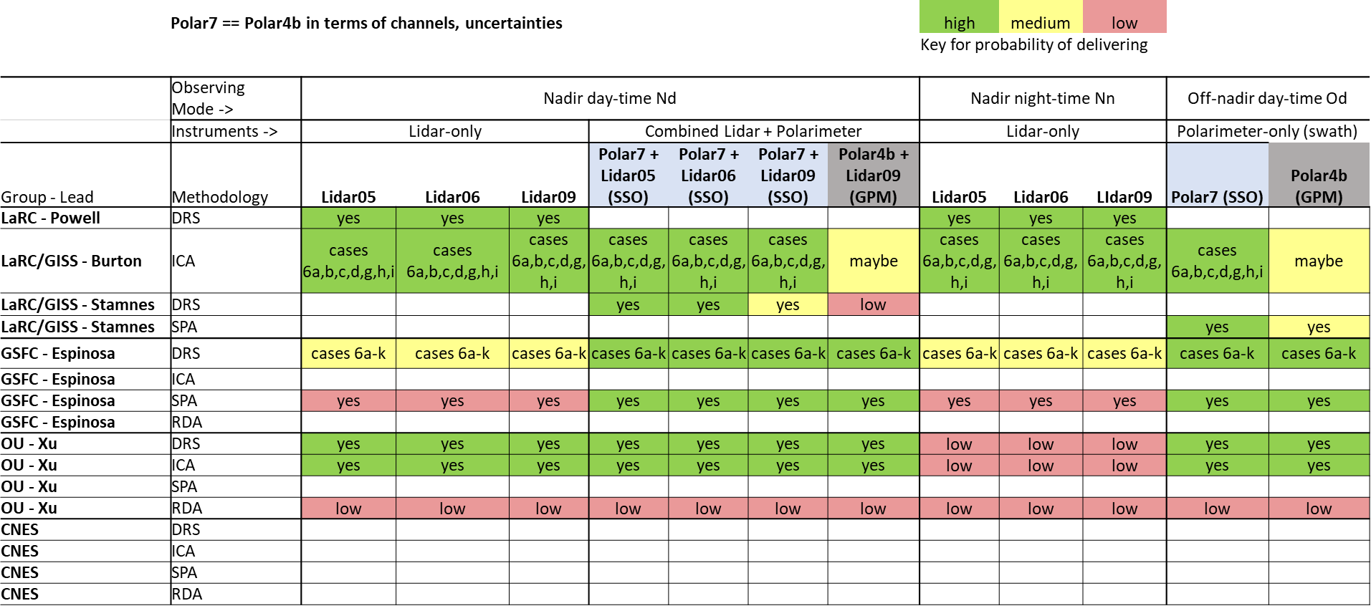
Interface with the Value Framework Team
For every methodology
For all canonical cases (DRS)
Report Uncertainties?
Example for vertically resolved GV
Aerosol Extinction (Total)
 | Raw Quality Scores from SIT-A
 | Source:
 | Nadir, Daytime | Nadir, Nighttime | Nadir, Nighttime | Off-nadir, Daytime
Avg in PBL - Land
Avg in PBL - Ocean
Avg Above PBL - Land
Avg Above PBL – Ocean
Example for column/PBL GV
Aerosol Optical Depth
 | Raw Quality Scores from SIT-A
 | Source:
 | Nadir, Daytime | Nadir, Nighttime | Nadir, Nighttime | Off-nadir, Daytime
PBL - Land
PBL - Ocean
Full Column - Land
Full Column - Ocean
Marie, Shaun, I swapped these rows!

Slide 25
Interface with the Value Framework Team
Submit files with individual Quality Scores
and Uncertainties – file naming convention:
NNN_TYP_PLTF_OBS_SRFC_RES#_V##.csv
Format: %8.3f
Fill value 999.000
(Group Name, NNN)
NLP (NASA LaRC Powell)
NLB
NLS
NGE (NASA GSFC Espinoza)
OUX (OU Xu)
CND (CNES Dubovik)
(Observing Mode, OBS, 3)
NAD – Nadir, Daytime
NAN – Nadir, Nighttime
OND – Off-Nadir, Daytime
(Surface, SRFC, 3)
LNDD (Desert)
LNDV (Vegetated)
OCEN
(Analysis Type, TYP)
ICA, SPA, RDA, DRS
If DRS/ICA, add case number:
DRS6i or ICA6i
DRSall… ICAall
(Version Number V##)
V01
V02…
(Platform/instr. combo,
PLTF, 4)
SSP0: SSP, lidar 5, pol 7
SSP1: SSP, lidar 6, pol 7
SSP2: SSP, lidar 9, pol 7
SSG3: SSG, lidar 9, pol 4b
(Resolution, RES#, 5)
RES1: 50kmH/500mV
RES2: 05kmH/500mV
RES3: 25kmH/500mV
RES4: 01kmH/30mV
RES5: 05kmH/30mV

Slide 26
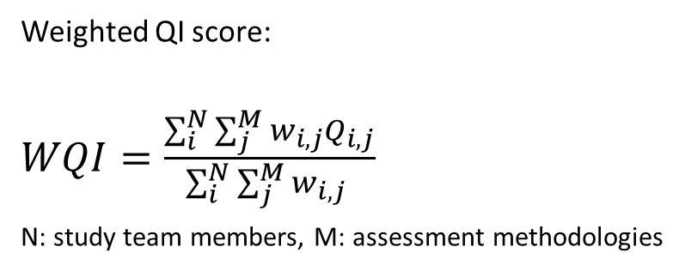
“Bundling” for Weighting, the Volume problem
GV# | GV name
1 | AAOD_l_UV_column | 1 - Combine by column/PBL
2 | AAOD_l_UV_PBL
3 | AAOD_l_VIS_column | 2
4 | AAOD_l_VIS_PBL
5 | AAOD_l_UV_column | 3
6 | AAOD_l_UV_PBL
7 | AAOD_l_VIS_column | 4
8 | AAOD_l_VIS_PBL
9 | ASYM_UV | 5 - ???
10 | ASYM_VIS
11 | AEFR_l_column | 6
12 | AEFR_l_PBL
13 | AE2BR_l_UV_column | 7
14 | AE2BR_l_UV_PBL
15 | AE2BR_l_VIS_column | 8
16 | AE2BR_l_VIS_PBL
21 | AODF_l_VIS_column | 9
22 | AODF_l_VIS_PBL
27 | ANSPH_l_VIS_column | 10
28 | ANSPH_l_VIS_PBL
31 | AOD_l_UV_column | 11
32 | AOD_l_UV_PBL
33 | AOD_l_VIS_column | 12
34 | AOD_l_VIS_PBL
35 | AOD_l_NIR_column | 13
36 | AOD_l_NIR_PBL
GV# | GV name
37 | APM25 | 14
38 | ARIR_l_column | 15
39 | ARIR_l_PBL
40 | AIIR_l_column | 16
41 | AIIR_l_PBL
42 | AABS_z_UV_profile_above_PBL | 17
43 | AABS_z_UV_profile_in_PBL
44 | AABS_z_VIS_profile_above_PBL | 18
45 | AABS_z_VIS_profile_in_PBL
46 | AEFR_z_profile_above_PBL | 19
47 | AEFR_z_profile_in_PBL
48 | AEXT_z_UV_profile_above_PBL | 20
49 | AEXT_z_UV_profile_in_PBL
50 | AEXT_z_VIS_profile_above_PBL | 21
51 | AEXT_z_VIS_profile_in_PBL
52 | AEXT_z_NIR_profile_above_PBL | 22
53 | AEXT_z_NIR_profile_in_PBL
54 | AE2BR_z_UV_profile_above_PBL | 23
55 | AE2BR_z_UV_profile_in_PBL
56 | AE2BR_z_VIS_profile_above_PBL | 24
57 | AE2BR_z_VIS_profile_in_PBL
62 | AEXTF_z_VIS_profile_above_PBL | 25
63 | AEXTF_z_VIS_profile_in_PBL
68 | ANSPH_z_VIS_profile_above_PBL | 26
69 | ANSPH_z_VIS_profile_in_PBL
72 | ANC_z_profile_above_PBL | 27
73 | ANC_z_profile_in_PBL
Submit files with individual Quality Scores
and Uncertainties – file naming convention:
NNN_TYP_PLTF_OBS_SRFC_RES#_V##.csv
~4 x 21 x 4 x 3 x 3 x 5 = 15,120 x 73 = >
1,103,760 QI scores, mean errors, RMSEs max
For every team and assessment type this requires:
4 x 3 x 3 x 5 = 180 x 73 => 13,140 weighting factors
Suggest instead:
~8 x 4 x 1-3 x 1 x 1 = 32 x 27 => 864-? weighting factors
Weighted QI score:
$WQI=\frac{\sum_{i}^{N}{\sum_{j}^{M}{w_{i,j}Q_{i,j}}}}{\sum_{i}^{N}{\sum_{j}^{M}{w_{i,j} }}}$
N: study team members, M: assessment methodologies

Slide 27
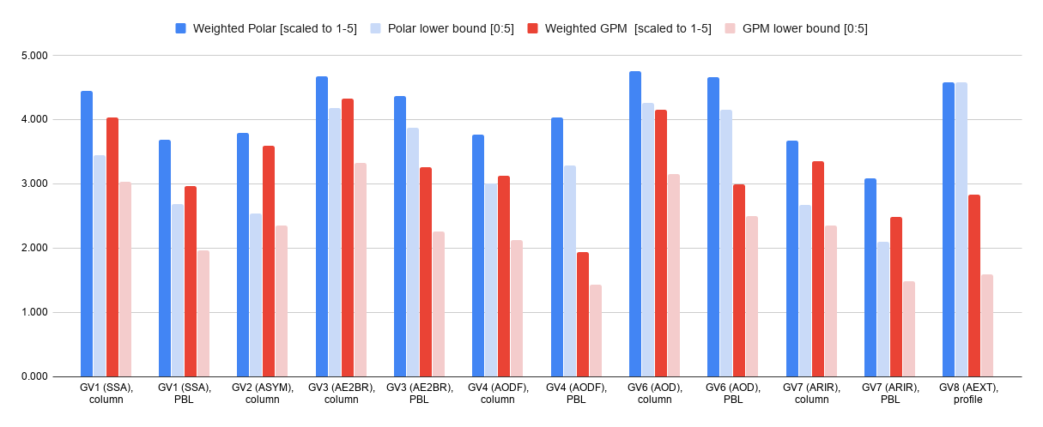
Format for GV reviews
NNN_TYP_PLTF_OBS_SRFC_RES#_V##.csv
QI(4 x 21 x 4 x 3 x 3 x 1)
Example: AAOD_l_UV_column
QI Score
Mean error
RMSE
QI Score
Mean error
RMSE

Slide 28
Timeline for expanded 8K assessments
Time period in 2020 | Action | People | Deliverable
Mar. 23 - 29 | Settle on vert/horiz resolutions for retrieval simulations | All | vert/horiz resolution rqt’s ✔
 | Discuss realistic list of GV’s | All | Proposed GV’s for this assessment
 | Devise lidar uncertainties | Powell, Yorks, Vaughan | Proposed 3+2 lidar uncertainties
 | Finalize comparison of polarizing land surface forward simulations | All polarimeter teams | Land surface models
Mar. 30 – Apr. 5 | Discuss use of NR geometry output | All | Methodology for using NR output
 | Finalize list of GV’s | All | GV’s for this assessment
 | Finalize lidar uncertainties | Powell, Yorks, Vaughan | Final 3+2 lidar uncertainties
Apr. 6 - 12 | Set-up all assessment codes | All assessment teams | Final sim codes
Apr. 13 - 19 | Retrieval simulations – 6 weeks | All assessment teams
Apr. 20 - 26
June 1 | Conclude all simulations | All assessment teams | Delivery of all QI scores
June 1 - Jun 8 | Provide oral presentations of individual assessment efforts | All pol&lidar teams | Preliminary QI scores
 | Discussion on Preliminary QI scores | Study team | Feedback/Questions to teams
 | Finalize QI scores | Study team | Final QI scores

Slide 29
Remaining slides are back-up

Slide 30
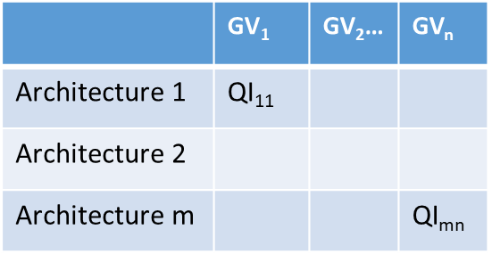

Step 1: Architecture performance evaluation methodologies
k Methods↓ j Groups → | LaRC/GISS | GSFC | OU
Information Content Analysis (ICA) | ✔x1 | ✘ | ✔x1
Direct retrieval simulation (DRS) | ✔x1 pol+lidar ✔x1lidar-only | ✔x1 pol+lidar | ✔x1 pol+lidar
Statistical DRS Performance Analysis (SPA) | ✔x1 | ✔x1 | ✘
Real Data Analysis (RDA) | Planned
L=# of✔ x QI scores
$$L { ∙QI}_{m,n}^{k, j}$$
Aerosol Model
Geophysical Variables (Truth)
Simulated Signals (Truth)
Instrument Model
Canonical Cases
RTX Model
G5 Nature Runs
Compare against σ_{SATM}
Quality Scores
DRS
Noise-added Signals
Geophysical Variables (Retrieved)
SPA
Real Data
Uncertainty estimates
RDA
ICA
Adapted from Lan Gao

Slide 31
Key decisions and considerations for 8G assessment:
QI scoring:
Focus on the seven Minimum GVs assessed prior to report to SCC in Dec 2019 (see ensuing slides)
Evaluate quality scores for 8G-polar and 8G-GPM separately
Consider eight (8) separate methodologies for assessing QI scores and uncertainties
Define QI scores as the fraction of “successful retrievals” for a given GV, i.e., fraction that yields uncertainties with the stated SATM capabilities
Study team weigthing and nudging:
Allow every study team member to assign weights to each methodology and GV in each of the three categories Validity/adequacy, Technical readiness, and Representativeness anonymously
Weight the QI scores of each methodology and GV by mean of validity, readiness and representativeness
In totality, the study team considers the resulting QI scores and uncertainties to be overly optimistic
The study team deliberated on probable lower bounds of the success rates of future retrieval
These lower bounds were expressed in terms of percentage decreases of successful retrievals and scaled to [0:5]
These lower bounds were derived on the basis of the mean QI scores and mean uncertainties, and represent the study team’s best estimate how the QI scores may decrease in the future, with more complex retrieval sim’s

Slide 32
Interface with the Value Framework Team
Expected by the VF Team:
Format: %8.3f
Fill value 999.000
Aerosol Extinction (Total)
Aerosol Non-Spherical Extinction Fraction
Aerosol Optical Depth​
Aerosol Absorption Optical Depth ​
Aerosol Fine Mode Optical Depth ​
Aerosol Real Index of Refraction ​
Aerosol Imaginary Index of Refraction
Aerosol Non-Spherical AOD Fraction ​
Aerosol Extinction to Backscatter Ratio​ (column)
Aerosol-Cloud Feature Mask​
Cloud Mask
Planetary Boundary Layer Height​​
Environmental Temperature​
Environmental Humidity​
Aerosol PM2.5 Concentration ​
Aerosol Effective Radius (profile)
Aerosol Absorption ​(profile)
Aerosol Fine Mode Extinction ​(profile)
Aerosol Extinction to Backscatter Ratio (profile)
Environmental Horizontal Wind​
Environmental Vertical Wind​

Slide 33
Computational resource estimate
OU example - for current canonical cases:
Instrument combinations:
SSP: 3xlidar-only (fast), 1xpol, 3xlidar+pol
SSG: 1xlidar, 1xpol, 1lidar+pol
Number of runs per viewing geometry:
9 cases * 3 surfaces * 500 perturbations (noise + initial guess [surface + aerosol] + geometry angles) * 6 Instru. Combin. = 81,000 runs
Number of core hours per simulation for OU setup:
81,000 runs * 1 [cores/run] x 0.75 hrs = 60,750 core hrs
Computational time, with 18 nodes and (64+26) cores/node from condominium, plus 82 nodes and (20+10) cores/node from OSCER:
60,750 core hrs / (1,620 + 2,460) cores = 14.88 hrs ≈ 0.62 days

Slide 34
Some of the challenges in past (8G) assessment work
Balance between team-specific strengths (algorithms, forward simulations, etc.) and a set of “shared approaches”
Computational resources for some teams
Selection of experts on study team (to weigh and assess the retrieval work)
Weighting of assessments from different techniques to assess retrieval capabilities
Evaluation of instrument differences in light of the missing complexity of test cases

Slide 35


Architecture 8G’
2 Spacecraft
Mission Class: C
Orbit:
SSG: 406km
65 deg
SSP: 450 km
Sun-Synch
SSG (GPM Orbit)
SSP (Polar Orbit)
Radar12
Ka/W, Ka Doppler, nadir only, microsat
Radar12
Ka/W, Ka Doppler, nadir only, microsat
S_Polar07
35 kg, V, VNIR-SWIR Pol; .5% DOLP; 550km Swath; 60/10 angles
Aerosols
S_Polar07
35 kg, V, VNIR-SWIR Pol; .5% DOLP; 550km Swath; 60/10 angles
S_Lidar09
532 backscatter, 1064 backscatter, 4500 Hz, 5/3 mJ, 0.6 m
S_Lidar05
532 HSRL, 1064 backscatter
S-Radio09b
183.3 SSB FI-DC-7GHz, 325.5 SSB FI-DC-10Gzh, small, 35kg
S-Radio10
670, H&V-pol, cubesat (1.3 kg; 8W; TRL 6 by 2024)
S-Radio07
118(8 channels), 240, 310, 380(8 channels), 660, 880, cubesat, 3kg
S-Spec03
21kg, Nadir LWIR/FIR, Limb LWIR
119 kg
1000 kg

Slide 36
Ongoing and Future Work: Continuation of Assessment with More Realistic and Complex Simulations
Ongoing work:
Increase retrieval complexity (surfaces, realistic lidar uncertainties, viewing geometries, objective-specific canonical cases)
Extend list of Geophysical Variables
Extend to more Observing Modes (Nadir day-time, Nadir night-time, Off-Nadir, day-time, Off-Nadir night-time)
Directly compare different lidar systems in polar orbiting satellite with 8K (lidar 5), 8K-1 (lidar 6) and 8K-2 (lidar 9)
Future work:
Increase retrieval complexities for canonical cases:
Scene complexity
Retrievals below thin Cirrus
Retrievals above low clouds
Aerosol complexity
Larger large-mode sea-salt
Non-spherical aerosol types
Compare DRS and SPA methods on a subset of NR outputs
GEOS-5 Nature Runs:
Investigate sampling and yields using Nature Run
Joint PDF’s of aerosol property distributions to inform all teams’ DRS and SPA runs
Attribute input instrument uncertainties to random and systematic components
Include additional canonical cases directly relevant to specific objectives
Objective 8 (aerosol indirect) - low AOT cases (<0.1) to study cloud susceptibility to aerosols in low aerosol conditions during daytime
Objective 7 (direct effects) – include cases of aerosols under thin clouds and above bright clouds; tenuous aerosols often missed by previous satellite measurements

Slide 37
Main limitations of each assessment methodology, as perceived by assessment teams and used to arrive at lower bound QI scores for 8G assessments
Team/Methodology | Narrative of main limitations
1 LaRC - SPA polar | Lidar capability greater or equal to CALIOP daytime performance assumed, that is capable of locating, layering, and typing/classifying the aerosol between fine-mode and coarse-mode and identifying dust. "Lite" Polar07+lidar retrieval. Aerosol retrievals performed over ocean, which is an ideal situation compared to retrievals over land or cloud which will degrade performance. A fully combined retrieval which makes use of Lidar05 (HSRL-channels) will yield improvements over this "Lite" retrieval. The advantages of the SPA are that it gives idealized polarimeter-only performance assuming aerosol location/type is known, which in many cases it may be, e.g. over the ocean. And the retrieval was performed for a wide range of aerosol optical depth loadings, different aerosol microphysical properties, and varying instrument-sun viewing geometry configurations.
1 LaRC - SPA GPM | Same performance degradations for land-based retrievals as LaRC SPA polar. Performance improvements with a fully combined retrieval will be reduced using Lidar09.
2 LaRC - DRS polar | Only performed retrieval for SIT-A canonical aerosol case 6a. Very strong performance was partly due to use of Lidar06 (HSRL-2 channels), instead of using Lidar05 (HSRL-1), which will degrade performance. The Lidar05 will be used in the future. Performance over land and clouds is expected to reduced. Performance also needs to be evaluated for multiple instrument solar zenith angles and multiple AOD loadings.
2 LaRC - DRS GPM | To be completed.
3 OU - ICA polar | Constant assumption of aerosol microphysical properties and optical properties for all four aerosol species; analysis made assuming perfect convergence to the globally optimized solution; linear assumption of forward model in response to the perturbation x in Jacobian evaluation
3 OU - ICA GPM | same as OU - ICA for polar - orbiting
4 LaRC - ICA polar | Retrieval stability and global minimization errors not included; forward model error mostly not included (but has less strict assumptions about variability of aerosol properties than other methods); assumes random normal measurement uncertainties and does not include systematic measurement errors (i.e. calibration) or spectral correlation in errors. Includes 4 canonical cases only over water in principal plane. Does not take into account spatial inhomogeneity or any potential difficulties in combining lidar and polarimeter (i.e. mismatched footprint).
4 LaRC - ICA GPM | Same as LaRC -ICA GPM, but neglecting systematic measurement error may have larger proportionate effect in this case and simplifications of the aerosol scene in the canonical cases also expected to have more impact.
5 GSFC - DRS polar | uses two monomodal layers instead of two bimodal layers specified in canonical cases; α error was set to 12% instead of 17 Mm-1 used by other groups; 1.28 μm polarimeter channel was included; coarse mode CRI was retrieved; 10 angles used in 0.67 μm channel of polarimeter; additionally, all limitations of OU - DRS
5 GSFC - DRS GPM | uses two monomodal layers instead of the two bimodal layers specified in canonical cases; 1.28 μm polarimeter channel was included; coarse mode CRI was retrieved; 10 angles used in 0.67 μm channel of polarimeter; additionally, all limitations of OU - DRS
6 GSFC - SPA polar | uses two monomodal layers; α error was set to 12% instead of 17 Mm-1 used by other groups; 1.28 μm polarimeter channel was included; coarse mode CRI was retrieved; 10 angles used in 0.67 μm channel of polarimeter; additionally, all limitations of OU - DRS
6 GSFC - SPA GPM | uses two monomodal layers; 1.28 μm polarimeter channel was included; coarse mode CRI was retrieved; 10 angles used in 0.67 μm of channel polarimeter; additionally, all limitations of OU - DRS
7 LaRC - lidar DRS polar | There are a few questions about the lidar05 instrument specs as listed in the RFI. There has not been a decision as to size of the lidar footprint on the surface. This determines the Field-of-View and laser divergence. For this simulation assumed 90m footprint.
7 LaRC - lidar DRS GPM | The value applied for the Lidar09 532 nm calibration uncertainty was an estimate and needs to be specified. There are a few questions about the lidar instrument specs as listed in the RFI. There has not been a decision as to size of the lidar footprint on the surface. This determines the Field-of-View and laser divergence. For this simulation assumed 45m footprint.
8 OU - DRS polar | Retrieval assumes Gaussian noises for all signals; measurement bias excluded; Assumption of no correlation in measurements; May further double the sample size for higher precision
8 OU - DRS GPM | same as OU - DRS for polar - orbiting

Slide 38
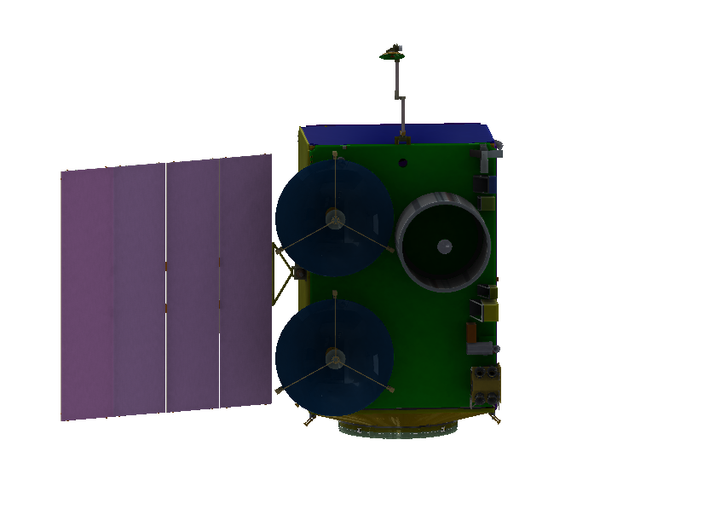
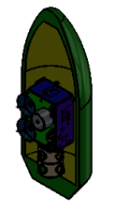
Architecture 8G SSP Fact Sheet
Radar13
Ka Doppler
W Doppler
SSP
 | Dry Mass/Fuel | Load Power
SSP SC | 1125/262 | 402
Payload
Radar13 | 44.2 | 78
Lidar05 | 435.5 | 643.5
Polar07 | 61.1 | 59.8
Radio07 | 3.9 | 15.6
Spect03 | 22.8 | 43.9
Total P/L | 568 | 841
Lidar05
532, 1064 nm
532 HSRL
Radiometer07
Spectrometer 03
Polarimeter 07
60 Angle
4mx2.6m
Payload & SC: $475-$564M
Launch Options: ACCP Single SC Dedicated
or Shared Ride with Another Program on
ESPA Grande & Falcon-9 to Polar Sun Sync Orbit
Total Obs Mass=1955kg; Pwr=1243W

Slide 39
8G SSP Instruments
450km
Polar Sun Sync
1:30p.m.
Radio07
Lidar05
Radar13
Spec03
Polar07

Slide 40
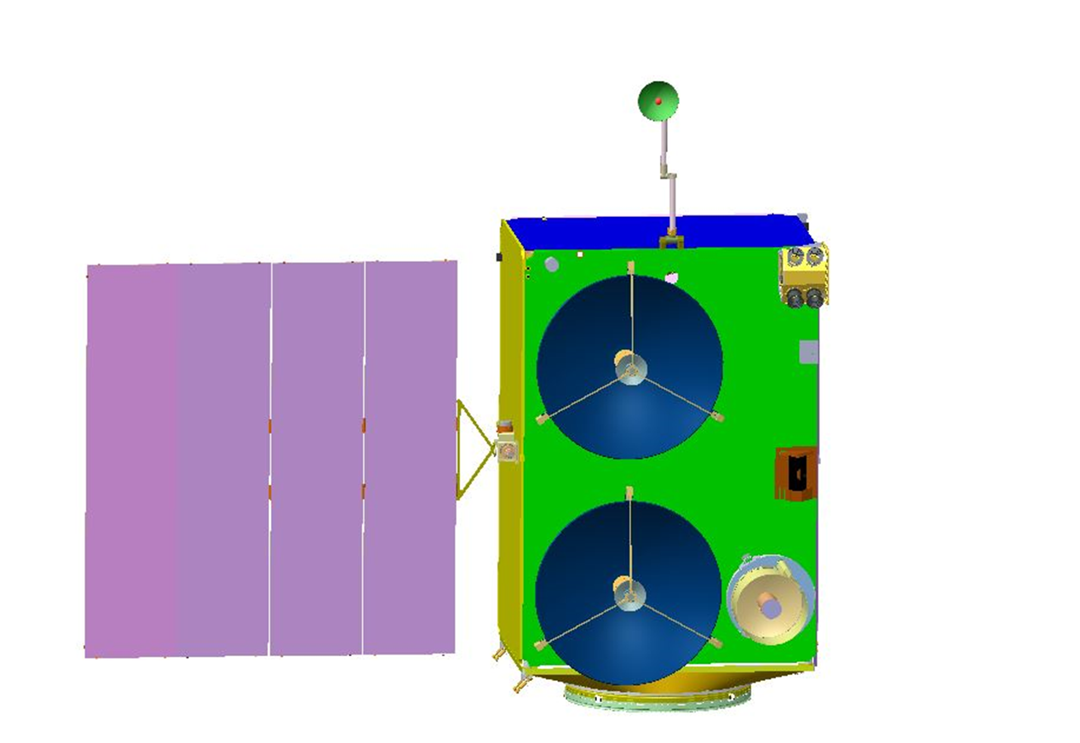
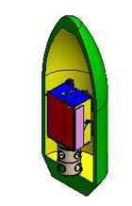
Architecture 8G SSG Fact Sheet
Radar13
Ka Doppler
W Doppler
SSG
Polarimeter 07
60 Angle
 | Dry Mass/Fuel kg | Load Power W
SSG SC | 1103/304 | 420
Payload
Radar13 | 44.2 | 78
Lidar09 | 74.1 | 341.9
Polar07 | 61.1 | 59.8
Radio9b | 45.5 | 48.1
Radio10 | 1.69 | 10.4
Total P/L | 227 | 538
Radiometer 10
Radiometer 9b
Lidar09
532, 1064 nm
Back-Scatter
4mx2.6m
Payload & SC: $216-$364M
Launch Options: ACCP Single SC Dedicated
or Shared Ride with Another Program on
ESPA Grande & Falcon-9 to 65 deg Inclined Orbit
Total Obs Mass=1634kg; Pwr=958W

Slide 41
8G SSG Instruments
Polar07
Radio10
Radar13
Radio9b
Lidar09
407km
65 deg incl

Slide 42
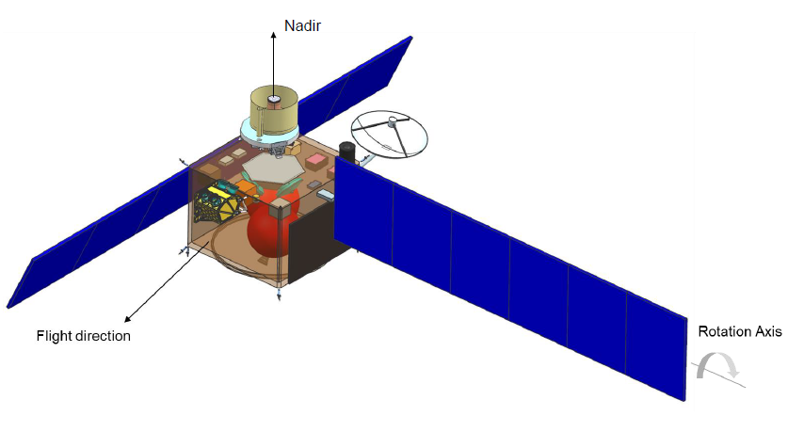
Architecture 8K SSG-1 Fact Sheet
Lidar09
532, 1064 nm
Back-Scatter
SSG-1
 | Dry Mass/Fuel | Load Power
SSG-1 SC | 689/199 | 326
Payload
Lidar09 | 74.1 | 341.9
Polar04b | 27.3 | 59.8
Total P/L | 101.4 | 401.7
Polarimeter 07
60 Angle
Total Obs Mass=989.4kg; Pwr=728W
Payload & SC: $112-$169M
Launch Options: ACCP SSG-1 and SSG-2
Share Ride on ESPA Grande in
Falcon 9 to 65 deg Inclined Orbit

Slide 43
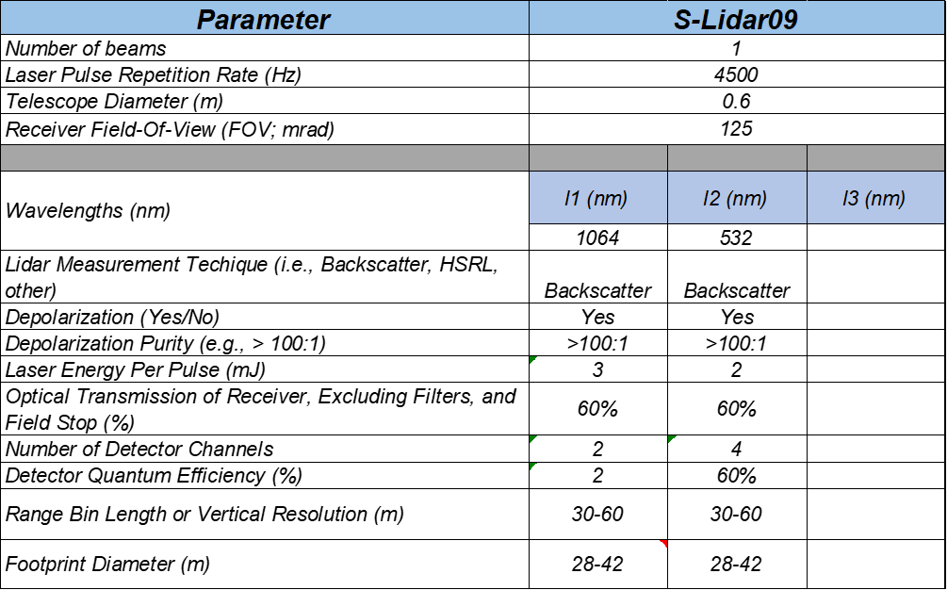
8K SSG-1 Instruments
407km
65 deg incl
Lidar09
Polar4b

Slide 44
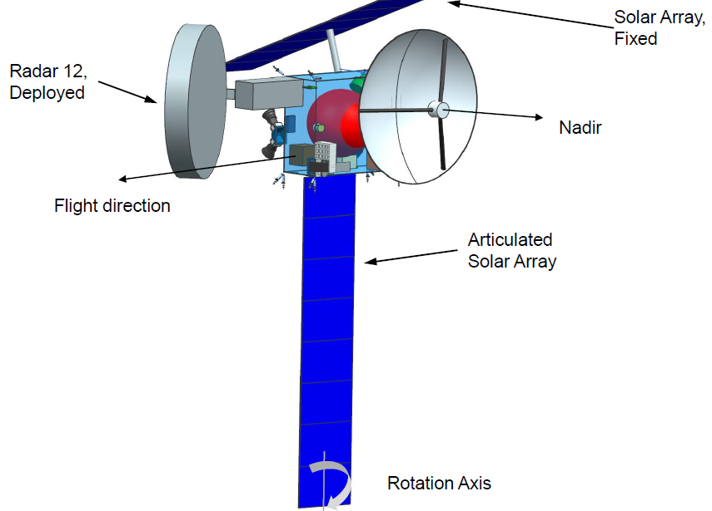
Architecture 8K SSG-2 Fact Sheet
 | Dry Mass/Fuel | Load Power
SSG-2 SC | 394/122 | 467
Payload
Radar12 | 28.6 | 78
Radio07 | 3.9 | 15.6
Total P/L | 32.5 | 93.6
Ka Doppler
W No Doppler
Radiometer07
Total Obs Mass=548.5kg; Pwr=560.6W
Payload & SC: $56-$110M
Launch Options: ACCP SSG-1 and SSG-2
Share Ride on ESPA Grande in
Falcon 9 to 65 deg Inclined Orbit

Slide 45
8K SSG-2 Instruments
Radar12
Radio07
407km
65 deg incl

Slide 46
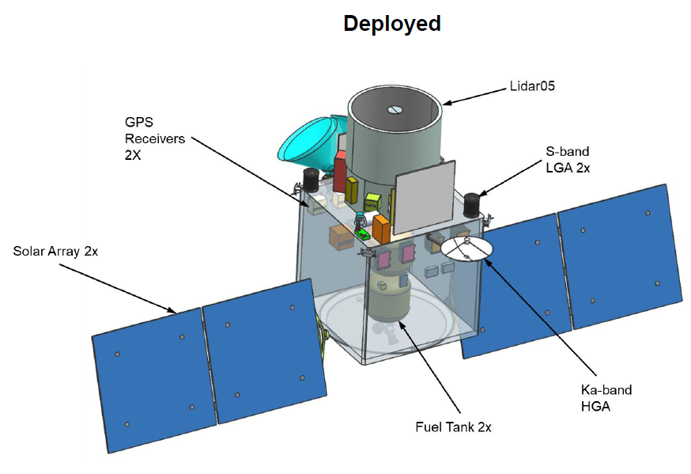
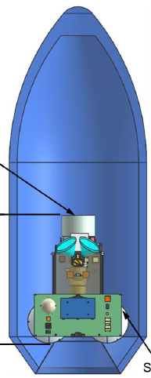
Architecture 8K SSP-1 Fact Sheet
 | Dry Mass/Fuel kg | Load Power W
SSG-1 SC | 1142/184 | 437
Payload
Lidar05 | 435.3 | 643.5
Polar07 | 61.1 | 59.8
Spec03 | 22.8 | 43.9
Total P/L | 519.2 | 747.2
Total Obs Mass=1845.2kg; Pwr=1184.8W
Payload & SC: $307-$445M
Launch Options: ACCP SSP1 & SSP2
Share Ride on ESPA Grande in
Falcon 9 to 65 deg Polar Orbit

Slide 47
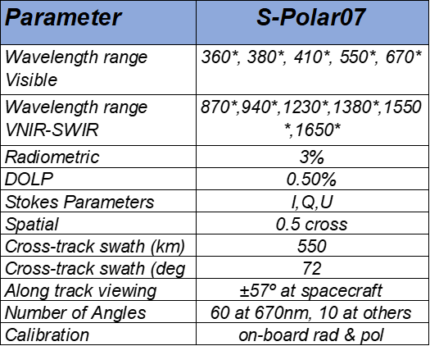
8K SSP-1 Instruments
450km
Polar Sun Sync
1:30p.m.
Spec03
Lidar05
Polar07
Need picture
that better shows
Instrument layout

Slide 48
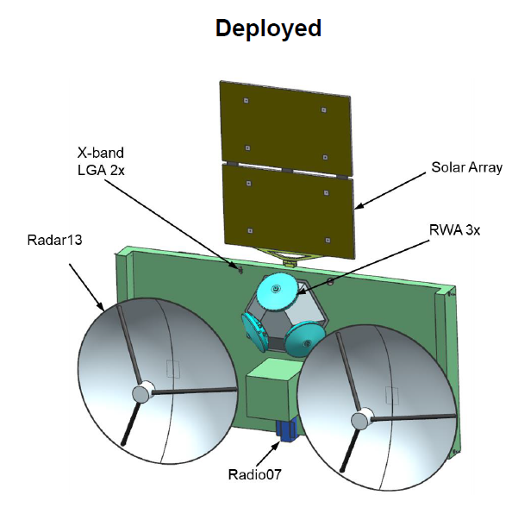
Architecture 8K SSP-2 Fact Sheet
 | Dry Mass/Fuel | Load Power
SSP-2 SC | 256/51 | 157
Payload
Radar13 | 44.2 | 78
Radio07 | 3.9 | 15.6
Total P/L | 48.1 | 93.6
Total Obs Mass=355.1kg; Pwr=250.6W
Payload & SC: $101-$124M
Launch Options: ACCP SSP-1 and SSP-2
Share Ride on ESPA Grande in
Falcon 9 to 65 deg Inclined Orbit

Slide 49
8K SSP-2 Instruments
450km
Polar Sun Sync
1:30p.m.
Radar13
Radio07

Slide 50
Considerations for relative weighting and adjusting:
Validity/adequacy of a given methodology to assess uncertainties and quality scores (i.e., fundamentally, is the methodology and its use capable of assessing the retrieval quality?)
Technical readiness (i.e., in its current implementation, is the methodology providing realistic and physically plausible results and are shortcomings known and quantifiable).
Representativeness (i.e., has the method been applied to a representative range of aerosol and scene conditions? is the result likely applicable to a wider range of conditions than what is has been tested on?)
Relative Impact of Completeness of canonical case table on Confidence in Score
Relative Impact of Scene complexity on Confidence in Score
Relative Impact of Frequency of occurrence on Confidence in Score

Slide 51
Rubrics:
Validity/adequacy: Methodology is
5: is fundamentally sound and the best available for assessing the feasibility of providing a given GV with a given architecture (instrument combination)
4: is sound and generally well suited for ….
3: is appropriate, but has some limitations for …
2: has limited suitability …
1: is mostly inappropriate …
0: is entirely inappropriate …

Slide 52
Rubrics:
Technical readiness: Methodology…
5: is fully developed and has no significant aspects that can be improved; capabilities are fully understood.
4: is well developed; limitations are well understood and their impact on assessment results is well constrained.
3: is reasonably well developed and implemented; there is some understanding of how to interpret the current results …
2: has significant need for improvements; limitations are mostly unknown and interpretation of results is mostly uncertain …
1: is poorly implemented; limitations are unknown and interpretation of results is unknown…
0: is immature; limitations are completely unknown …

Slide 53
Rubrics:
Representativeness: Methodology…
5: is applied to all available data so as to enable a complete assessment of the feasibility of providing a given GV with a given architecture (instrument combination)
4: is applied to a fairly complete set of data, with the impact of limitations on the assessment well understood.
3: is applied to an incomplete set of data, yet the impact of limitations on the assessment is reasonably well understood.
2: is applied to a very incomplete set of data with the impact of limitations on the assessment not well understood.
1: is applied to a very incomplete set of data with the impact of limitations on the assessment unknown.…

